Slide 1
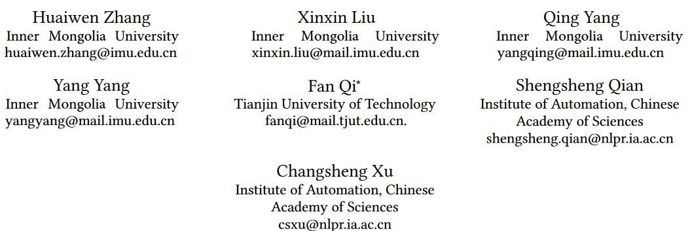
ATAI
Advanced Technique of Artificial Intelligence
ATAI
ChongqingUniversity _{AdvancedTechniqueof}
of Technology Artificial Intelligence
Chongqing University of Technology
Chongqing University ^{ATAI}
_{of Technology} Advanced Techniqueof
Artificial Intelligence
Chongqing University of Technology
Chongqing University of Technology
T3RD: Test-Time Training for Rumor Detection on Social Media
Code:https://github.com/social-rumors/T3RD
—— WWW ’24
Reported by Shu Ming Jiang
1

Slide 2
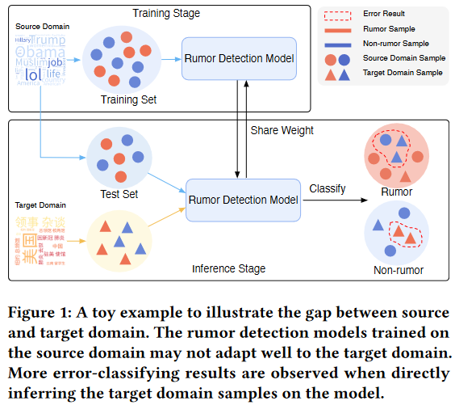
ATAI
Advanced Technique of
Artificial Intelligence
ATAI
ChongqingUniversity _{AdvancedTechniqueof}
of Technology Artificial Intelligence
Chongqing University of Technology
Introduction
(1When facing emergent events or rumors propagated in different languages, the performance of these models is significantly degraded, due to the lack of training data and prior knowledge (low resource).

Slide 3
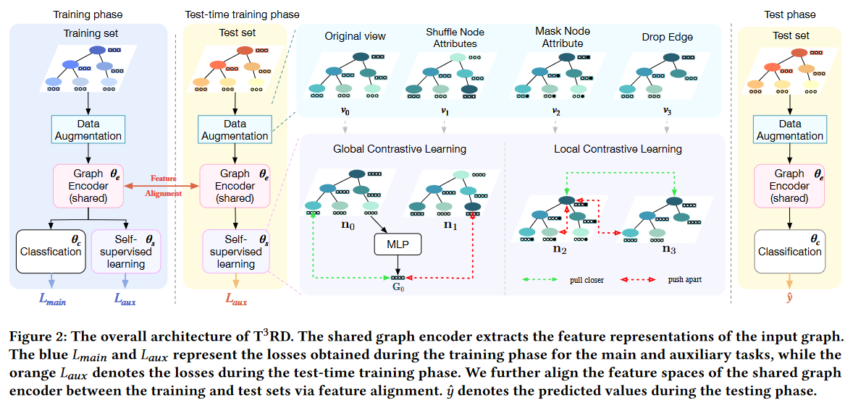
ATAI
Advanced Technique of
Artificial Intelligence
ATAI
ChongqingUniversity _{AdvancedTechniqueof}
of Technology Artificial Intelligence
Chongqing University of Technology
Overview

Slide 4
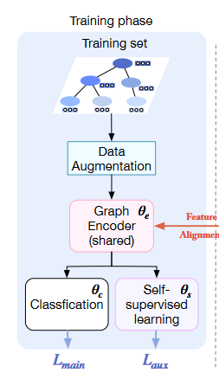
ATAI
Advanced Technique of
Artificial Intelligence
ATAI
ChongqingUniversity _{AdvancedTechniqueof}
of Technology Artificial Intelligence
Chongqing University of Technology
Method

Slide 5
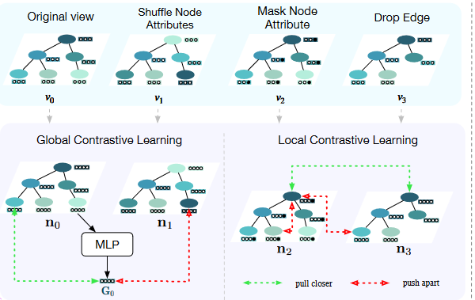
ATAI
Advanced Technique of
Artificial Intelligence
ATAI
ChongqingUniversity _{AdvancedTechniqueof}
of Technology Artificial Intelligence
Chongqing University of Technology
Method

Slide 6
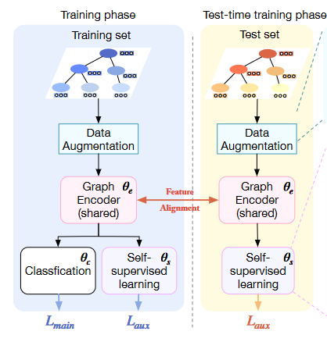
ATAI
Advanced Technique of
Artificial Intelligence
ATAI
ChongqingUniversity _{AdvancedTechniqueof}
of Technology Artificial Intelligence
Chongqing University of Technology
Method

Slide 7
ATAI
Advanced Technique of
Artificial Intelligence
ATAI
ChongqingUniversity _{AdvancedTechniqueof}
of Technology Artificial Intelligence
Chongqing University of Technology
Experiments

Slide 8
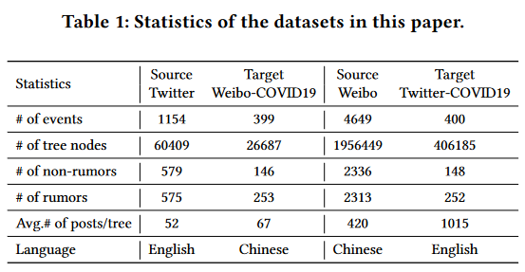
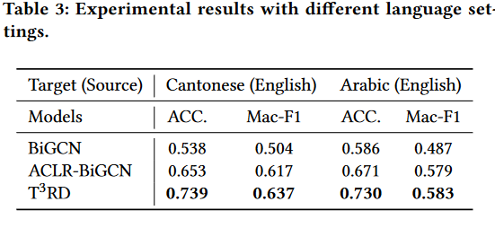
ATAI
Advanced Technique of
Artificial Intelligence
ATAI
ChongqingUniversity _{AdvancedTechniqueof}
of Technology Artificial Intelligence
Chongqing University of Technology
Experiments

Slide 9
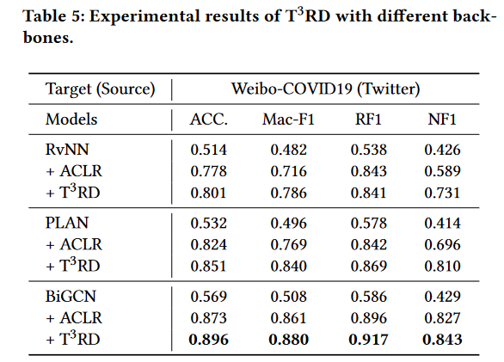
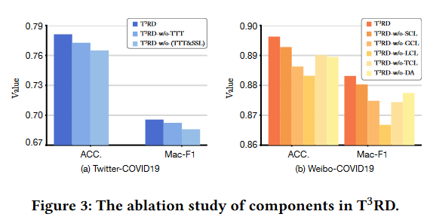
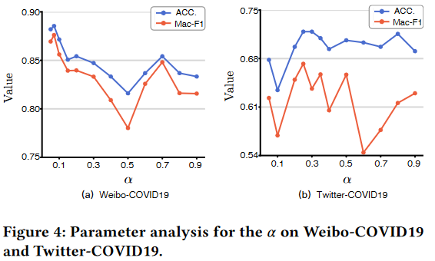
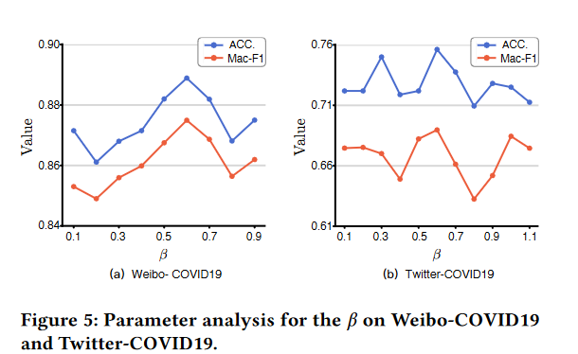
ATAI
Advanced Technique of
Artificial Intelligence
ATAI
ChongqingUniversity _{AdvancedTechniqueof}
of Technology Artificial Intelligence
Chongqing University of Technology
Experiments

Slide 10
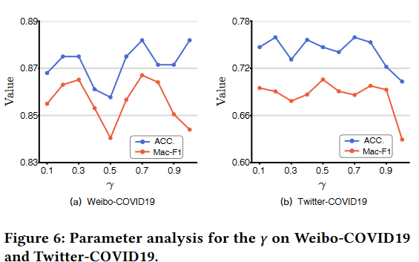
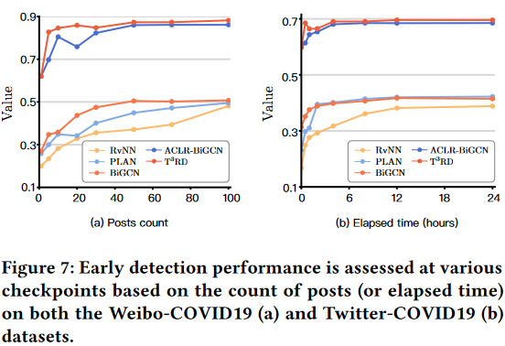
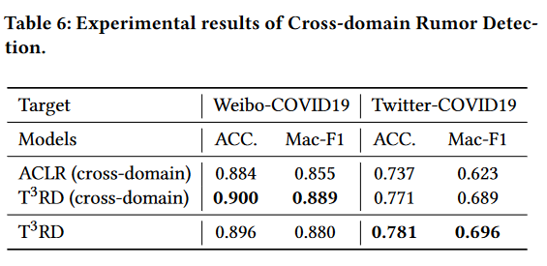
ATAI
Advanced Technique of
Artificial Intelligence
ATAI
ChongqingUniversity _{AdvancedTechniqueof}
of Technology Artificial Intelligence
Chongqing University of Technology
Experiments

Slide 11
ChongqingUniversity of Technology
ATAI
Advanced Technique of
Artificial Intelligence
ATAI
ChongqingUniversity _{AdvancedTechniqueof}
of Technology Artificial Intelligence
Chongqing University of Technology
Thanks!

